Slide 1

Welcome to Oak Class
Teacher - Mrs Stoner
Teaching Assistant - Mrs Lyle

Slide 2













Accelerated Reader
Computer based programme which assesses children’s levels in reading
Children read books of suitable ability and interest within their level
Once the book is read, children will complete a quiz on that specific book
Experts state that children who read at least 20 minutes per day and have a 90% comprehension rate (on their quizzes), will make accelerated progress in reading
The more that children read, the more progress they will make, therefore children will still be expected to read every evening

Slide 3
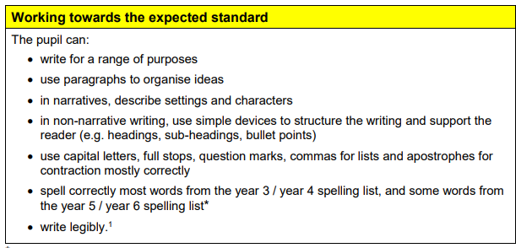
English Expectations

Slide 4

English Expectations

Slide 5
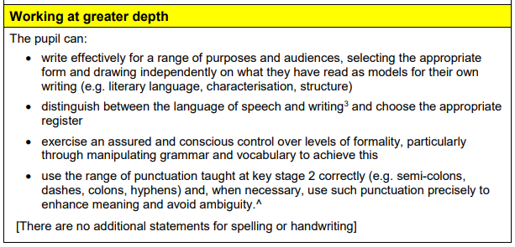
English Expectations

Slide 6

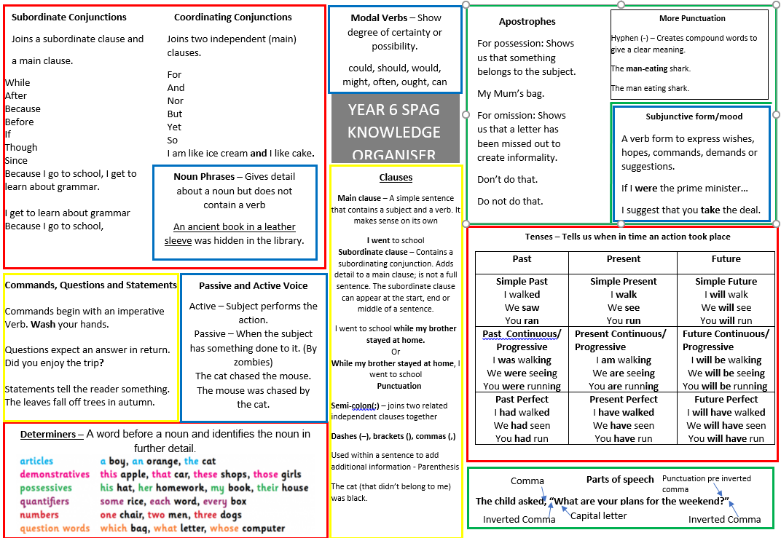
English Resources

Slide 7
Maths Knowledge
Year 4 12 x12
Your Child’s Revision Guide

Slide 8
Maths Expectations
T:\Classes\2015 +\Oak\numeracy\resources - maths\Your child's maths revision guide.docx
NCETM
All of Year 5 and 6 will be working together in Oak Class, taught by Mrs Stoner, Mrs Sharrock and Mrs Lyle.
Miss Filfil and Mrs Lyle will be focusing on arithmetic on Wednesdays.

Slide 9

Maths Mat

Slide 10
Homework Expectations
Daily spelling tasks – please check and sign
Reading Homework – Children are expected to read for a minimum of 10 minutes a night. – Optimum reading time would be around 20 minutes reading and discussing book with an adult.
There will also be some grammar questions (SATs style) for the children to complete.
T:\Curriculum\English\Reading\Questions to ask your children when they read with you.docx
Maths Homework
This will be based on the number facts and maths knowledge that is essential to support the strategies and methods that are taught in school.
There will also be topic homework, which will be due in every 2 weeks.

Slide 11
Behaviour Expectations
Uniform inc earrings etc.
P.E. kit
Behaviour before and after school
Role models
Respect for each other and property – legal responsibility

Slide 12
Rewards
Role Model and Learner of the week
Class marbles
Head teacher Award
Always Club

Slide 13
Attendance
Including arriving to school on time
Attending every day matters!
There is a very clear link between attending in all year groups and achieving well in school. In fact, sustaining 96% attendance means a pupil is more likely to reach the expected standard in both English and Maths than a pupil who is at 90%

Slide 14
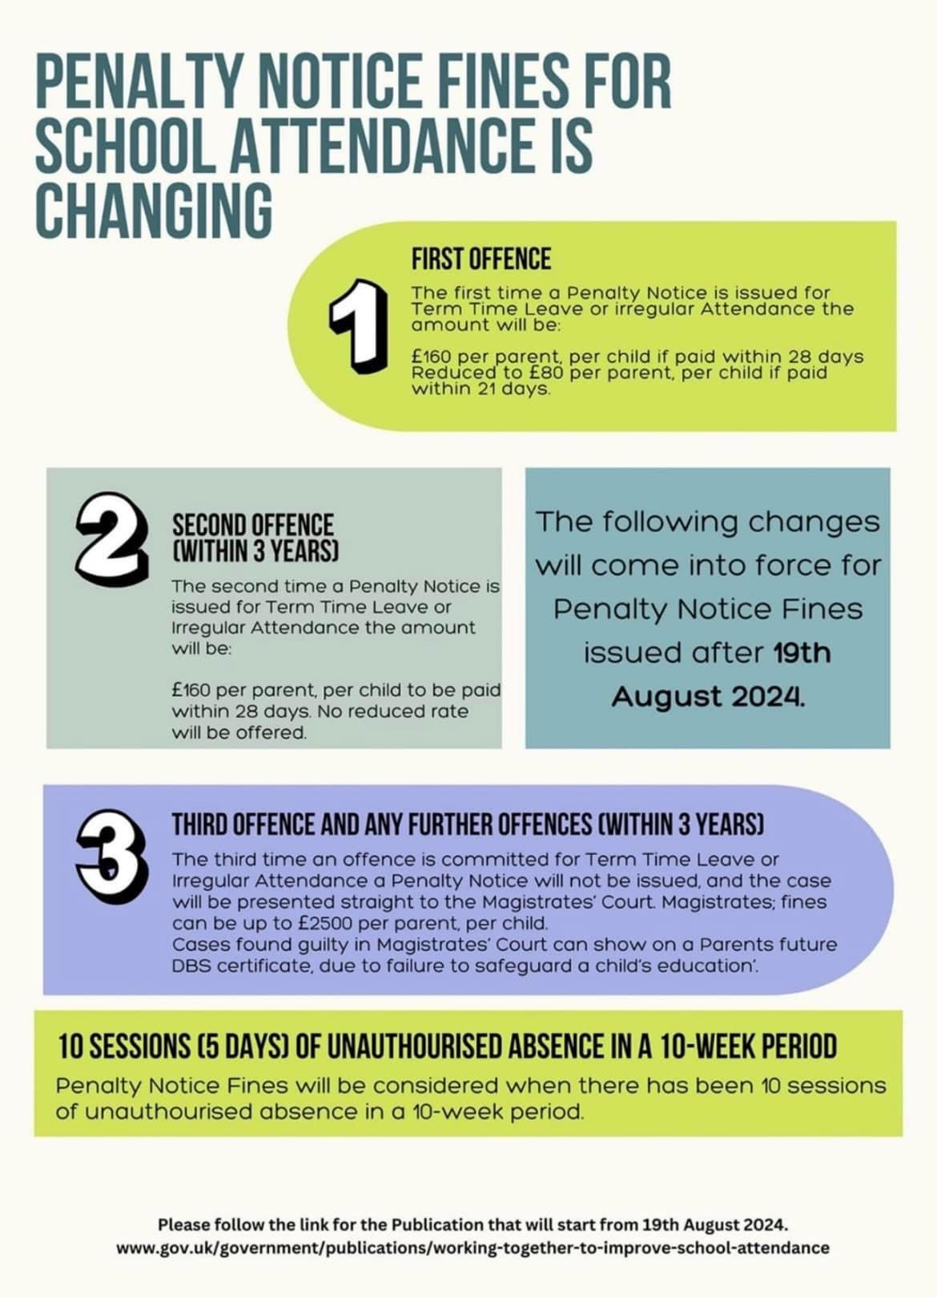
Requests for absence in learning time
The Education (Pupil Registration) (England) Regulations 2013 only permit headteachers to authorise absence where exceptional circumstances apply. The guidance for headteachers explains that ‘exceptional’ is likely to be rare, significant, unavoidable and short.

Slide 15
Absence in learning time
Attendance during one school year | Equals so many days absent | Which is approximately so many weeks absent | Means this number of lessons missed
95% | 9 | 2weeks | 50
90% | 19 | 4weeks | 100
85% | 29 | 6weeks | 150
80% | 38 | 8weeks | 200
75% | 48 | 10 weeks | 250
70% | 57 | 11.5 weeks | 290
65% | 67 | 13.5 weeks | 340
Doors open at 8.40, enabling children to be sat at their desk either reading or completing spelling activities by 8.45. Whilst registration is at 8.50, if this is when they are arriving each day, whilst they may not be late, they can be missing nearly an hour’s learning time each week.

Slide 16


Pencil Cases and Rucksacks

Slide 17

Nut Free school

Slide 18
St John’s Website
St. Johns Baptist Primary School - St Johns Baptist Primary School
Newsletters

Slide 19

Any Questions

